Slide 1
Kindness Challenge

Slide 2
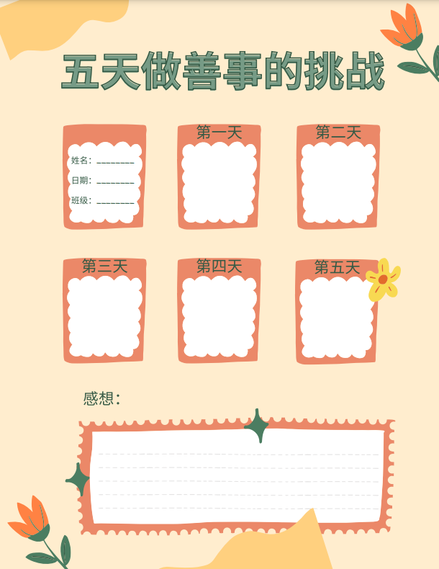
At the beginning of the unit:
Use "Kindness Journal" to record your 5-day variety experiences in the acts of kindness
Record your everyday kindness challenge, what did you do, how it made you feel, and the reactions of others. Ex. 我帮妈妈洗碗，我很高兴，妈妈很高兴。
After 5 days, write down a reflection about your experience of Kindness Challenge by using the two new key sentence structure from this unit. “...的时候”， “...让...” ，“越...越...”

Slide 3
做善事挑战的清单
A list of acts of kindness challenge
给人一个微笑、拥抱
写一张感谢卡送人
对别人说一些赞美的话
主动跟你平时不说话的人说话
参加做义工去帮助别人
给需要的人捐款
为人开门、随手关灯
捡起身边小垃圾
9. 跟别人分享快乐、食物
10. 帮家人买菜、做饭、洗碗、打扫
卫生、做家务
11. 照顾弟弟妹妹，给他们读故事书，
帮助他们学业上的问题
12. 给人送上一杯咖啡、热巧克力、
奶茶、礼物、花、自己做的手工

Slide 4
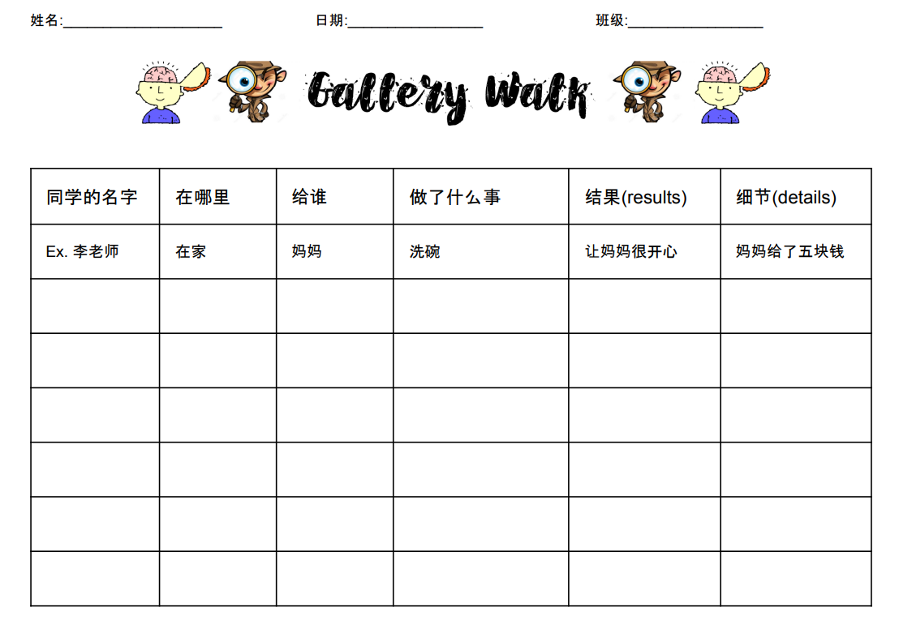
Activity: Gallery Walk Interpersonal Speaking (formative assessment)
Instructions:
Student (presenter) will talk about their kindness journal, another student (audience) will ask follow up questions.
Students will use gallery walk graphic organizer to take note during each station.
Ex. 第一天，我帮妈妈洗碗，让妈妈很开心。第二天，我给弟弟妹妹读故事的时候，他们很安静。第三天......。你平时帮家人做家务吗？（conversation）
Students rotate to a new station.

